Slide 1
Chapter 10:
PROJECTILE AND SATELLITE MOTION

Slide 2
This lecture will help you understand:
Projectile Motion
Fast-Moving Projectiles – Satellites
Circular Satellite Orbits
Elliptical Orbits
Kepler’s Laws of Planetary Motion
Energy Conservation and Satellite Motion
Escape Speed

Slide 3
Projectile Motion
Without gravity, a tossed object follows a straight-line path.
With gravity, the same object tossed at an angle follows a curved path.
Projectile:
Any object that moves through the air or space under the influence of gravity, continuing in motion by its own inertia

Slide 4
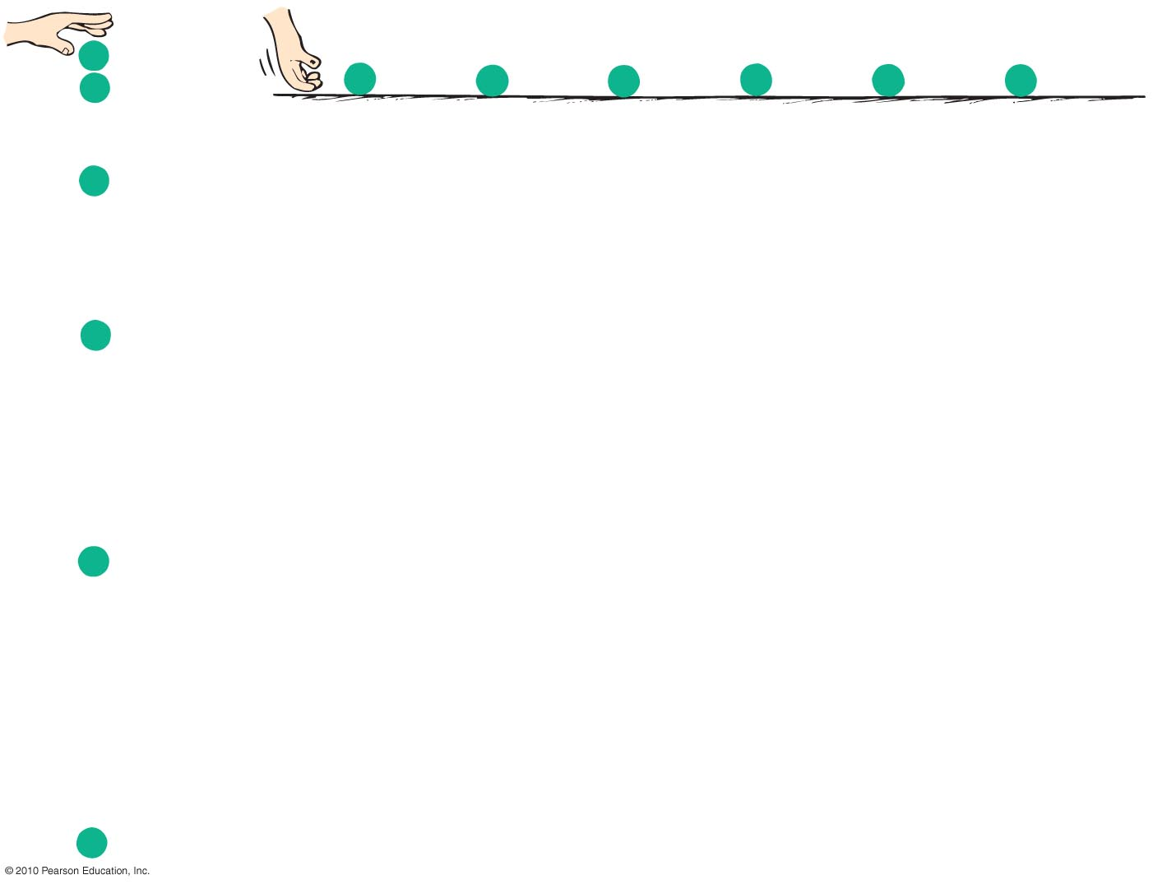
Projectile Motion
Projectile motion is a combination of
a horizontal component, and
a vertical component.

Slide 5
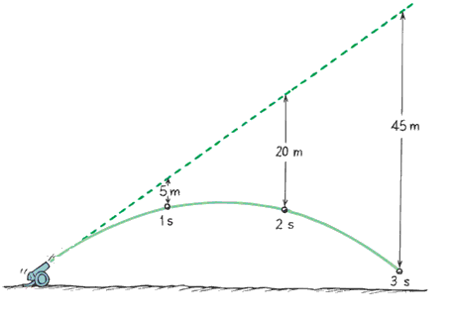
Projectile Motion
Projectiles launched horizontally
Important points:
Horizontal component of velocity doesn’t change (when air drag is negligible).
Ball travels the same horizontal
distance in equal times (no
component of gravitational
force acting horizontally).
Remains constant.

Slide 6
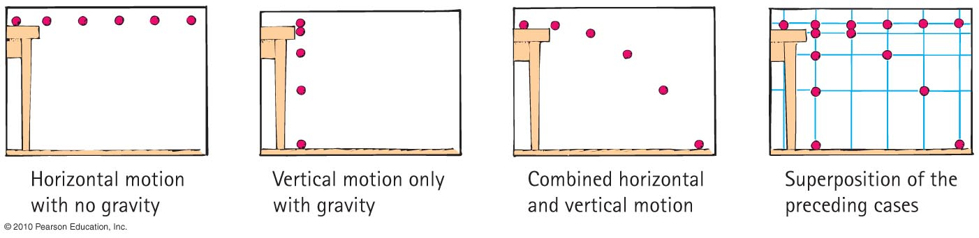
Projectile Motion
Vertical positions become farther apart with time.
  Gravity acts downward, so ball accelerates downward.
Curvature of path is the combination of horizontal and vertical components of motion.

Slide 7
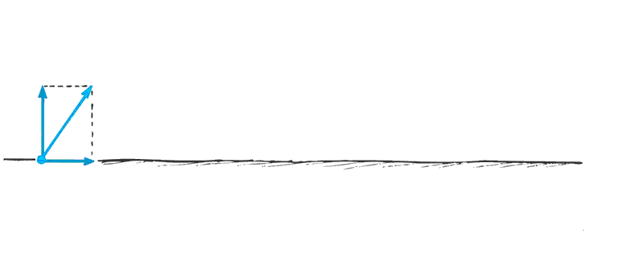
Projectile Motion
Parabola:
Curved path of a projectile that undergoes acceleration only in the vertical direction, while moving horizontally at a constant speed

Slide 8
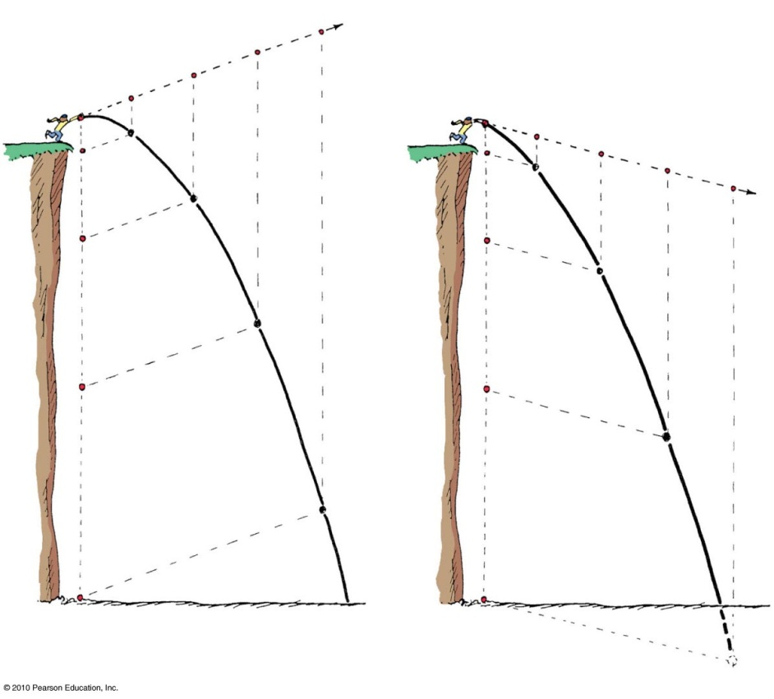
Projectile Motion
Projectiles launched at an angle:
Paths of stone thrown at an angle upward and downward
  Vertical and horizontal components are independent of each other.

Slide 9
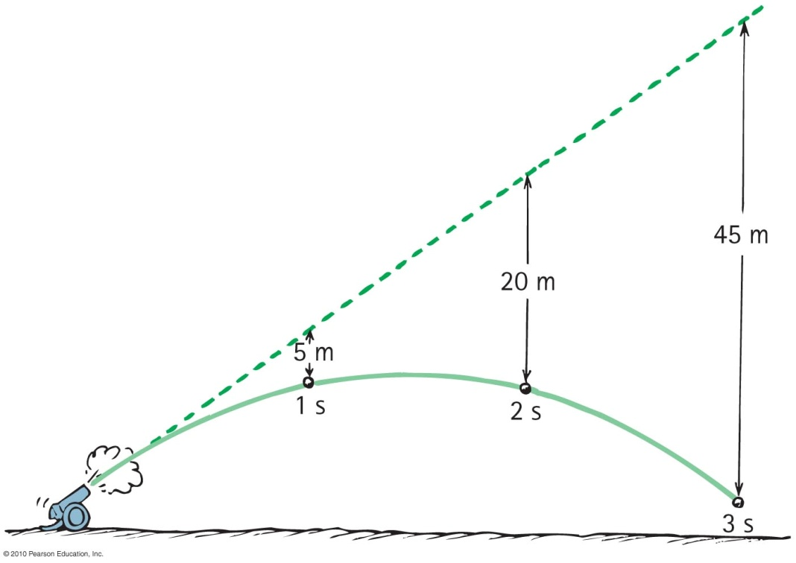
Projectile Motion
Paths of a cannonball shot at an upward angle
  Vertical distance that a stone falls is the same vertical distance it would have fallen if it had been dropped from rest and been falling for the same amount of time (5t²).

Slide 10
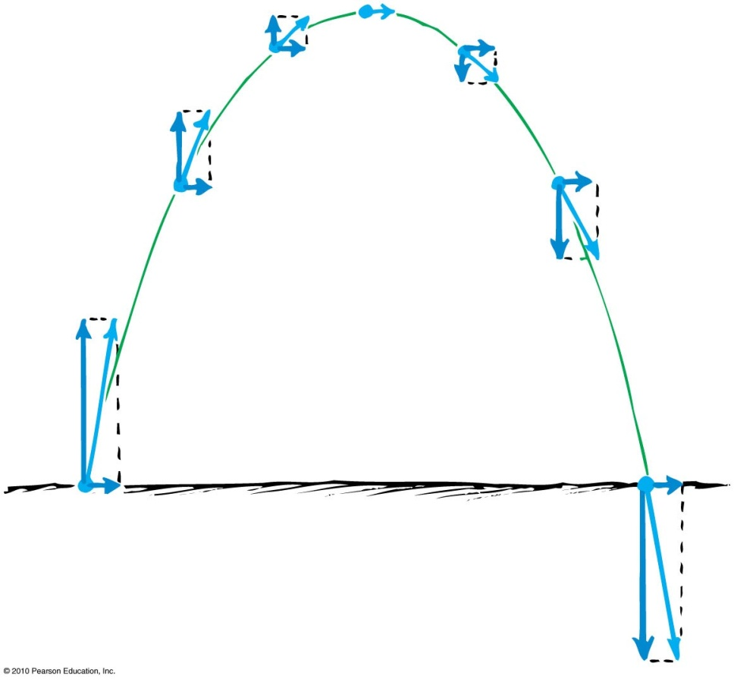
Projectile Motion
Paths of projectile following a parabolic trajectory
  Horizontal component along trajectory remains unchanged.
  Only vertical component changes.
  Velocity at any point is computed with the Pythagorean theorem (diagonal of rectangle).

Slide 11
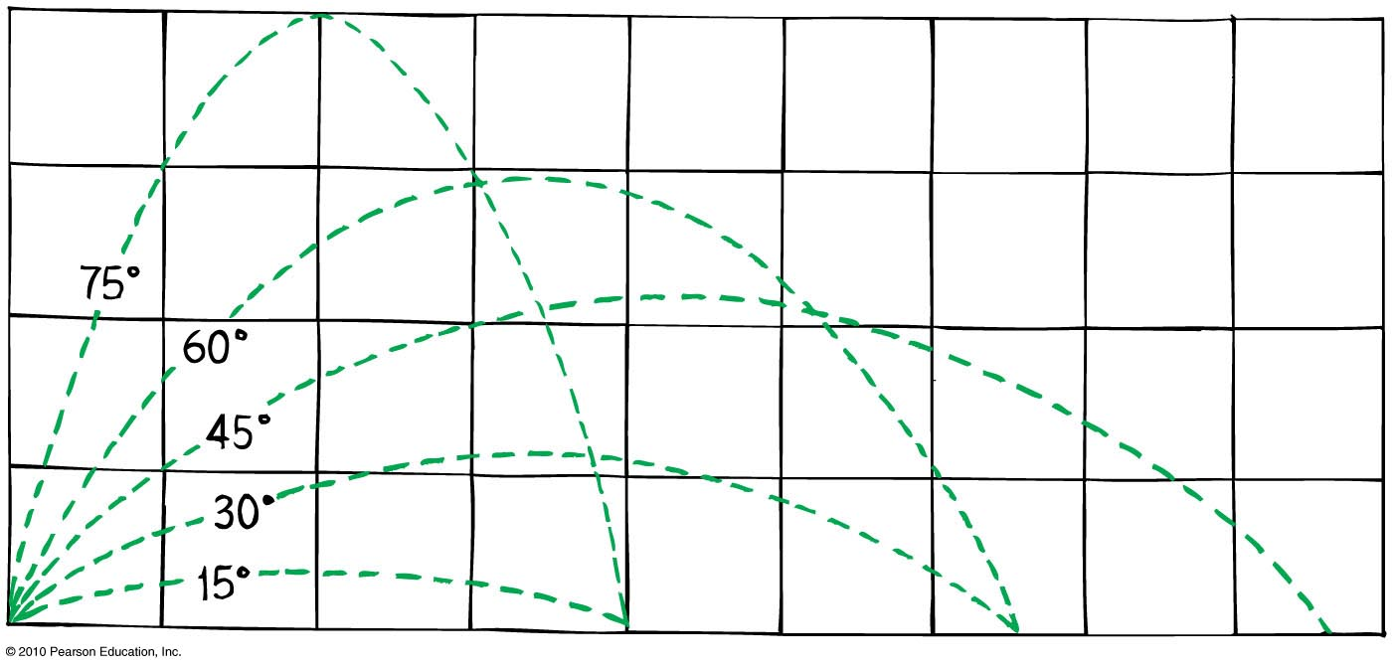
Projectile Motion
Different horizontal distances
  Same range is obtained from two different launching angles when the angles add up to 90°.
    Object thrown at an angle of 60° has the same range as if it were thrown at an angle of 30°.

Slide 12
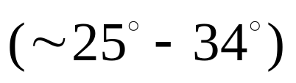
Projectile Motion
Different horizontal distances (continued)
  Maximum range occurs for ideal launch at 45°.
  With air resistance, the maximum range occurs for a baseball batted at less than 45° above the horizontal .
  With air resistance the maximum range occurs when a golf ball is hit at an angle less than 38°.

Slide 13
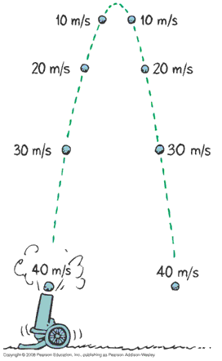
Projectile Motion
Without air resistance, the time for a projectile to reach maximum height is the same as the time for it to return to its initial level.

Slide 14
The velocity of a typical projectile can be represented by horizontal and vertical components. Assuming negligible air resistance, the horizontal component along the path of the projectile
Projectile Motion
CHECK YOUR NEIGHBOR
A. increases.
decreases.
remains the same.
Not enough information.
Notes:
C. remains the same.

Slide 15
The velocity of a typical projectile can be represented by horizontal and vertical components. Assuming negligible air resistance, the horizontal component along the path of the projectile
Projectile Motion
CHECK YOUR ANSWER
A. increases.
decreases.
remains the same.
Not enough information.
Explanation:
Since there is no force horizontally, no horizontal acceleration occurs.
Notes:
C. remains the same.

Slide 16
When no air resistance acts on a fast-moving baseball, its acceleration is
Projectile Motion
CHECK YOUR NEIGHBOR
A. downward, g.
a combination of constant horizontal motion and accelerated downward motion.
opposite to the force of gravity.
centripetal.
Notes:
A. downward, g.

Slide 17
When no air resistance acts on a fast-moving baseball, its acceleration is
Projectile Motion
CHECK YOUR ANSWER
A. downward, g.
a combination of constant horizontal motion and accelerated downward motion.
opposite to the force of gravity.
centripetal.
Notes:
A. downward, g.

Slide 18
Neglecting air drag, a ball tossed at an angle of 30° with the horizontal will go as far downrange as one that is tossed at the same speed at an angle of
Projectile Motion
CHECK YOUR NEIGHBOR
A. 45°.
60°.
75°.
None of the above.
Notes:
B. 60°.

Slide 19
Neglecting air drag, a ball tossed at an angle of 30° with the horizontal will go as far downrange as one that is tossed at the same speed at an angle of
Projectile Motion
CHECK YOUR ANSWER
A. 45°.
60°.
75°.
None of the above.
Explanation:
Same initial-speed projectiles have the same range when their launching angles add up to 90°. Why this is true involves a bit of trigonometry—which, in the interest of time, we’ll not pursue here.
Notes:
B. 60°.

Slide 20
Fast-Moving Projectiles—Satellites
Satellite motion is an example of a high-speed projectile.
A satellite is simply a projectile that falls around Earth rather than into it.
  Sufficient tangential velocity needed for orbit.
  With no resistance to reduce speed, a satellite goes around Earth indefinitely.

Slide 21
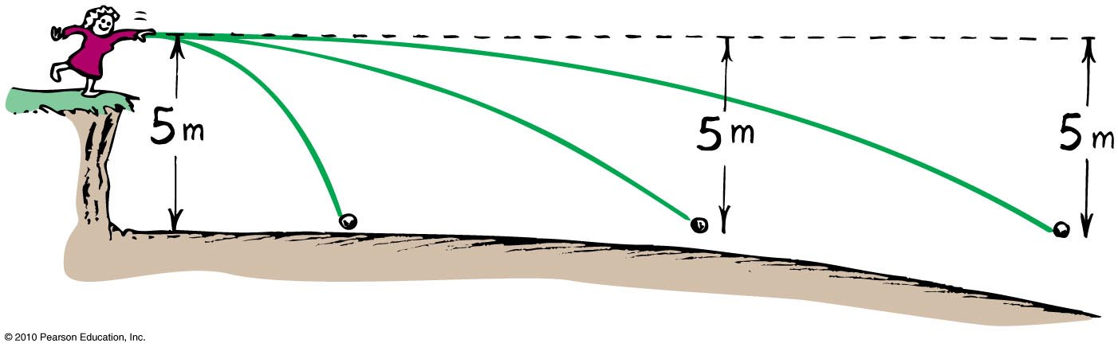
As the ball leaves the girl’s hand, 1 second later it will have fallen
Fast-Moving Projectiles—Satellites
CHECK YOUR NEIGHBOR
A. 10 meters.
5 meters below the dashed line.
less than 5 meters below the straight-line path.
None of the above.
Notes:
B. 5 meters below the dashed line.

Slide 22
As the ball leaves the girl’s hand, 1 second later it will have fallen
Fast-Moving Projectiles—Satellites
CHECK YOUR ANSWER
A. 10 meters.
5 meters below the dashed line.
less than 5 meters below the straight-line path.
None of the above.
Comment:
Whatever the speed, the ball will fall a vertical distance of 5 meters below the dashed line.
Notes:
B. 5 meters below the dashed line.

Slide 23
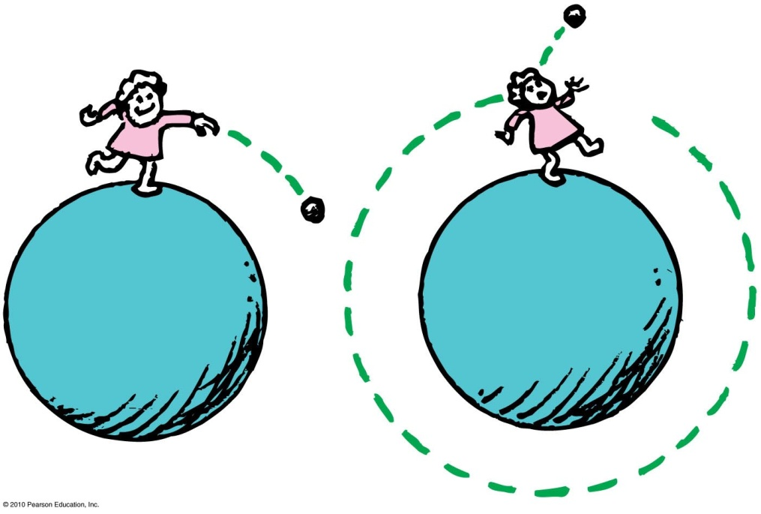
Circular Satellite Orbits
Satellite in circular orbit
Speed
  must be great enough to ensure that its falling distance matches Earth’s curvature.
  is constant—only direction changes.
  is unchanged by gravity.

Slide 24
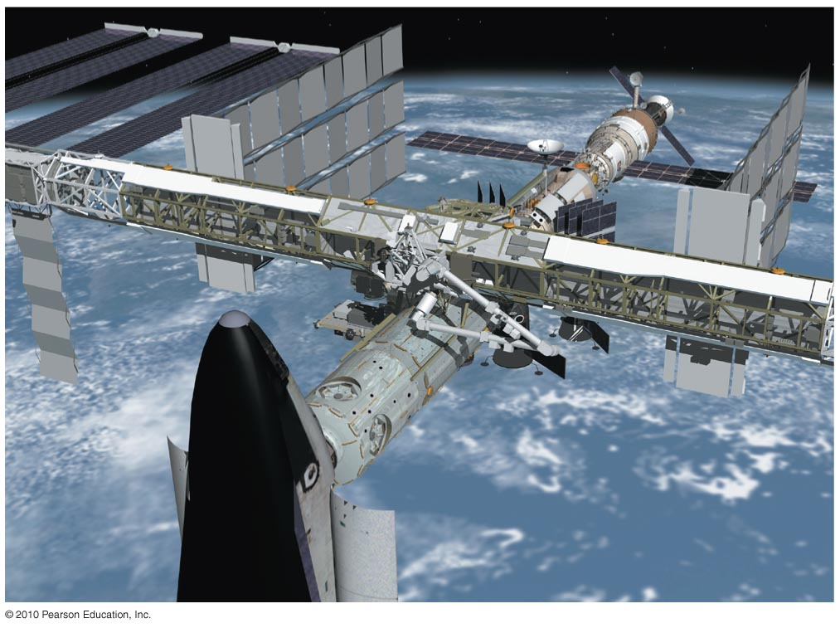
Circular Satellite Orbits
Positioning:
  beyond Earth’s atmosphere, where air resistance is almost totally absent
  Example: Space shuttles are launched to altitudes of 150 kilometers or more, to be above air drag
  (But even the ISS, as shown experiences some air drag, which is compensated for with periodic upward boosts.)

Slide 25
Circular Satellite Orbits
Motion
  moves in a direction perpendicular to the force of gravity acting on it
Period for complete orbit about Earth
    for satellites close to Earth—about 90 minutes
    for satellites at higher altitudes—longer periods

Slide 26
Earth Satellites
The orbital speed for close orbit about Earth is 8 km/s.
  That is an impressive 29,000 km/h (or 18,000 mi/h).
  At that speed, atmospheric friction would burn an object to a crisp.
  A satellite must stay 150 kilometers or more above Earth’s surface—to keep from burning due to the friction.

Slide 27
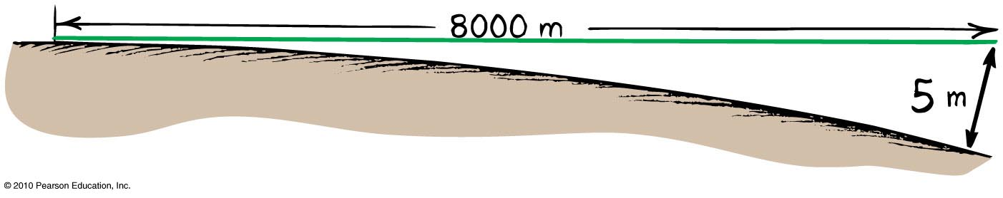
Circular Satellite Orbits
Curvature of Earth
Earth surface drops a vertical distance of 5 meters for every 8000 meters tangent to the surface

Slide 28
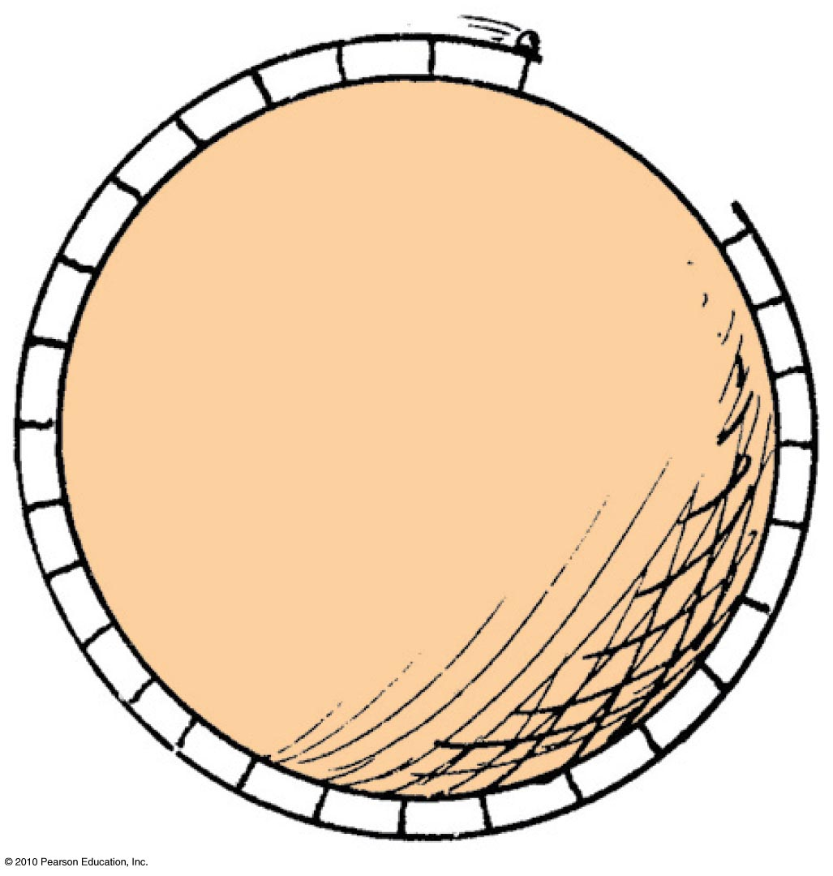
Circular Satellite Orbits
What speed will allow the ball to clear the gap?

Slide 29
Circular Orbits
For a satellite close to Earth, the time for a complete orbit around Earth, its period, is about 90 minutes.
For higher altitudes, the orbital speed is less and the period is longer.

Slide 30
Circular Orbits
Communications satellites are located in orbit 6.5 Earth radii from Earth’s center, so that their period is 24 hours.
This period matches Earth’s daily rotation. They orbit in the plane of Earth’s equator and they are always above the same place.
The moon is farther away, and has a 27.3-day period.

Slide 31
When you toss a projectile sideways, it curves as it falls. It will be an Earth satellite if the curve it makes
Circular Satellite Orbits
CHECK YOUR NEIGHBOR
A. matches the curved surface of Earth.
results in a straight line.
spirals out indefinitely.
None of the above.
Notes:
A. matches the curved surface of Planet Earth.

Slide 32
When you toss a projectile sideways, it curves as it falls. It will be an Earth satellite if the curve it makes
Circular Satellite Orbits
CHECK YOUR ANSWER
A. matches the curved surface of Earth.
results in a straight line.
spirals out indefinitely.
None of the above.
Explanation:
For an 8-km tangent, Earth curves downward 5 m. Therefore, a projectile traveling horizontally at 8 km/s will fall 5 m in that time, and follow the curve of Earth.
Notes:
A. matches the curved surface of Planet Earth.

Slide 33
When a satellite travels at a constant speed, the shape of its path is
Circular Satellite Orbits
CHECK YOUR NEIGHBOR
A. a circle.
an ellipse.
an oval that is almost elliptical.
a circle with a square corner, as seen throughout your book.
Notes:
A. a circle.

Slide 34
When a satellite travels at a constant speed, the shape of its path is
Circular Satellite Orbits
CHECK YOUR ANSWER
A. a circle.
an ellipse.
an oval that is almost elliptical.
a circle with a square corner, as seen throughout your book.
Notes:
A. a circle.

Slide 35
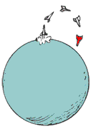
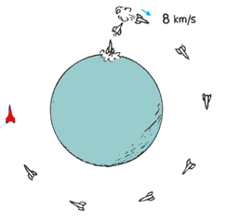
Circular Satellite Orbits
A payload into orbit requires control over
direction of rocket.
  Initially, rocket is fired vertically, then tipped.
  Once above the atmosphere, the rocket is aimed horizontally.
speed of rocket
  Payload is given a final thrust to orbital speed of 8 km/s to fall around Earth and become an Earth satellite.

Slide 36
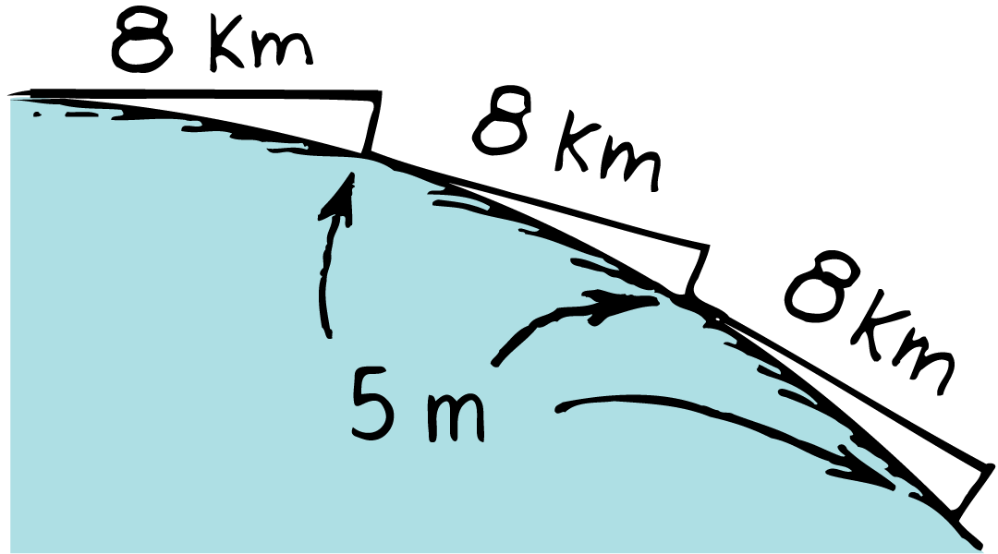
Circular Orbits
A satellite in circular orbit close to Earth moves tangentially at 8 km/s. During each second, it falls 5 m beneath each successive 8-km tangent.

Slide 37
Circular Orbits
think!
Satellites in close circular orbit fall about 5 m during each second of orbit. How can this be if the satellite does not get closer to Earth?

Slide 38
Circular Orbits
think!
Satellites in close circular orbit fall about 5 m during each second of orbit. How can this be if the satellite does not get closer to Earth?
Answer:
In each second, the satellite falls about 5 m below the straight-line tangent it would have taken if there were no gravity. Earth’s surface curves 5 m below an 8-km straight-line tangent. Since the satellite moves at 8 km/s, it “falls” at the same rate Earth “curves.”

Slide 39
Elliptical Orbits
An ellipse is the closed path taken by a point that moves in such a way that the sum of its distances from two fixed points is constant.
The two fixed points in an ellipse are called foci.
For a satellite orbiting a planet, the center of the planet is at one focus and the other focus could be inside or outside the planet.

Slide 40
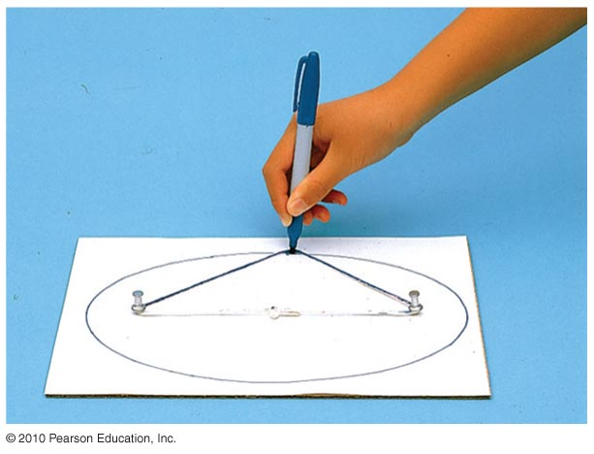
Elliptical Orbits
A projectile just above the atmosphere will follow an elliptical path if given a horizontal speed greater than 8 km/s.
Ellipse
  specific curve, an oval path
    Example: A circle is a special case of an ellipse when its two foci coincide.

Slide 41
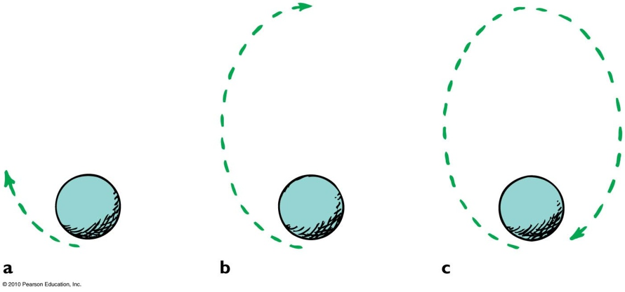
Elliptical Orbits
Elliptical orbit
Speed of satellite varies.
  Initially, if speed is greater than needed for circular orbit, satellite overshoots a circular path and moves away from Earth.
  Satellite loses speed and then regains it as it falls back toward Earth.
  It rejoins its original path with the same speed it had initially.
  Procedure is repeated.

Slide 42
The speed of a satellite in an elliptical orbit
Elliptical Orbits
CHECK YOUR NEIGHBOR
A. varies.
remains constant.
acts at right angles to its motion.
All of the above.
Notes:
A. varies.

Slide 43
The speed of a satellite in an elliptical orbit
Elliptical Orbits
CHECK YOUR ANSWER
A. varies.
remains constant.
acts at right angles to its motion.
All of the above.
Comment : A satellite in an elliptical orbit half the time recedes from Earth and loses speed and half the time approaches Earth and gains speed.
Notes:
A. varies.

Slide 44
Kepler’s Laws of Planetary Motion
Kepler was assistant to the famous astronomer Brahe, who directed the world’s first observatory.
He used data his mentor Brahe had collected on planetary motion to figure out the motion of planets.
He found that the motion of planets was not circular; rather, it was elliptical.

Slide 45
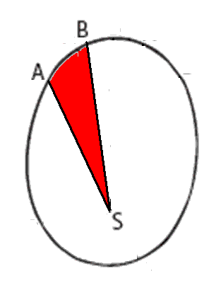
Kepler’s Laws of Planetary Motion
1st Law: The path of each planet around the Sun is an ellipse with the Sun at one focus.
2nd Law: The line from the Sun to any planet sweeps out equal areas of space in equal time intervals.
3rd Law: The square of the orbital period of a planet is directly proportional to the cube of the average distance of the planet from the Sun (for all planets).

Slide 46
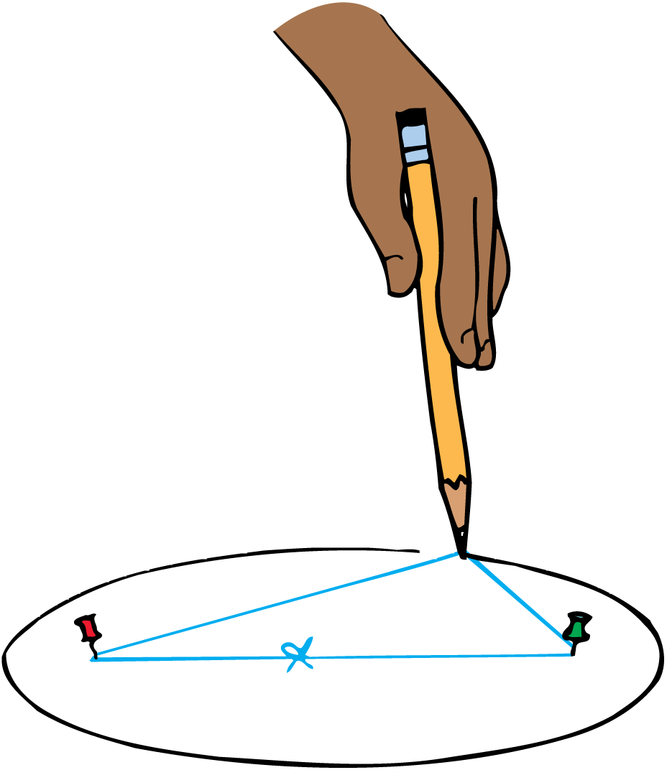
Kepler’s Laws of Planetary Motion
Kepler’s First Law
Kepler’s expectation that the planets would move in perfect circles around the sun was shattered after years of effort.
He found the paths to be ellipses.

Slide 47
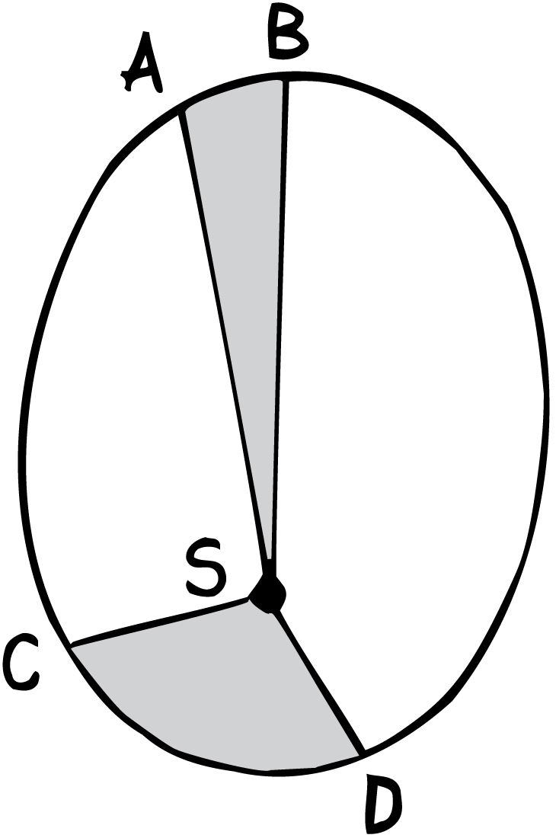
Kepler’s Laws of Planetary Motion
Equal areas are swept out in equal intervals of time.

Slide 48
Kepler’s Laws of Planetary Motion
Kepler’s Second Law
Kepler also found that the planets do not go around the sun at a uniform speed but move faster when they are nearer the sun and more slowly when they are farther from the sun.
An imaginary line or spoke joining the sun and the planet sweeps out equal areas of space in equal times.

Slide 49
Kepler’s Laws of Planetary Motion
Kepler was the first to coin the word satellite.
He had no clear idea why the planets moved as he discovered. He lacked a conceptual model.

Slide 50
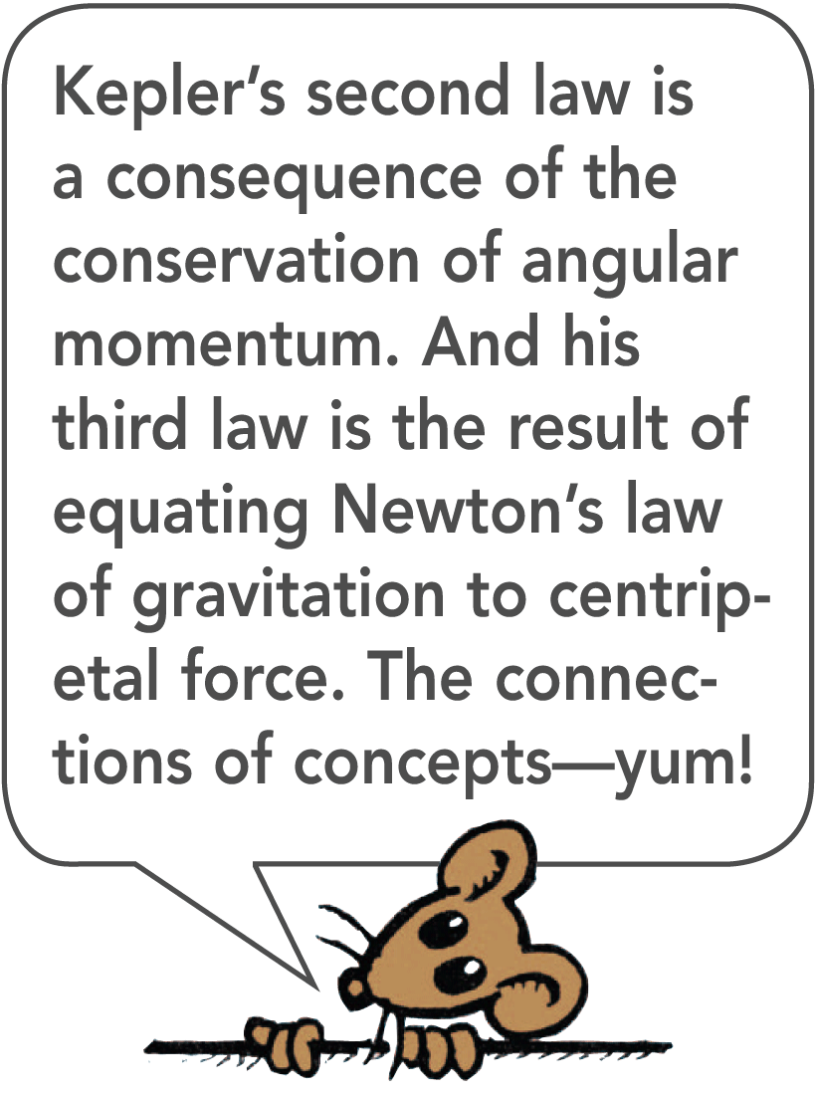
Kepler’s Laws of Planetary Motion
Kepler’s Third Law
After ten years of searching for a connection between the time it takes a planet to orbit the sun and its distance from the sun, Kepler discovered a third law.
Kepler found that the square of any planet’s period (T) is directly proportional to the cube of its average orbital radius (r).

Slide 51
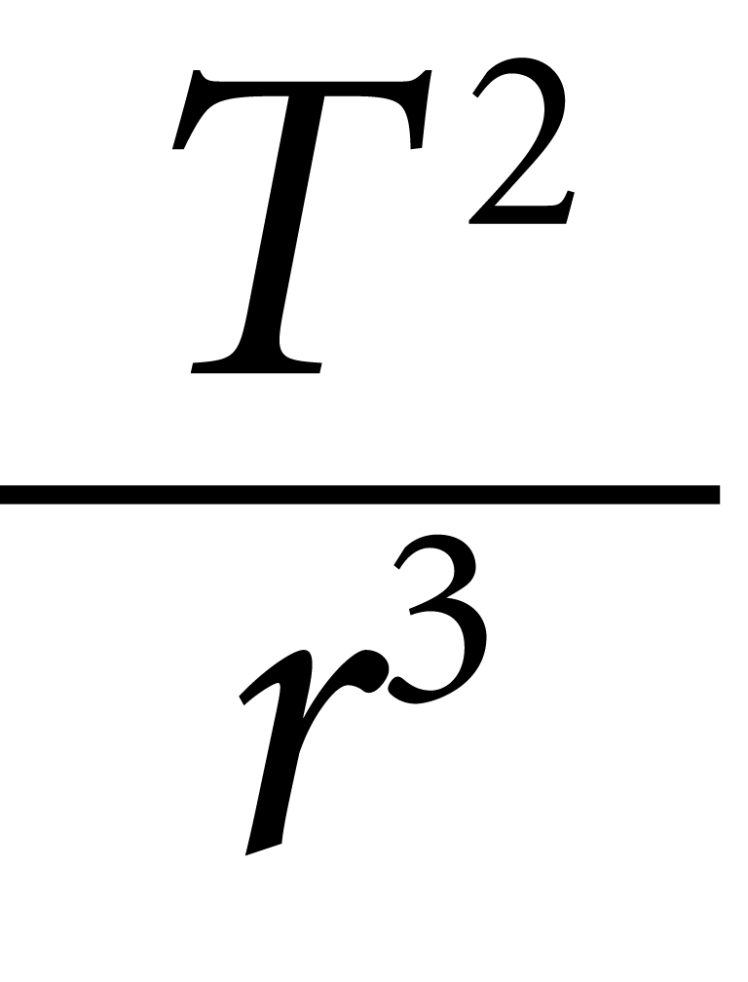
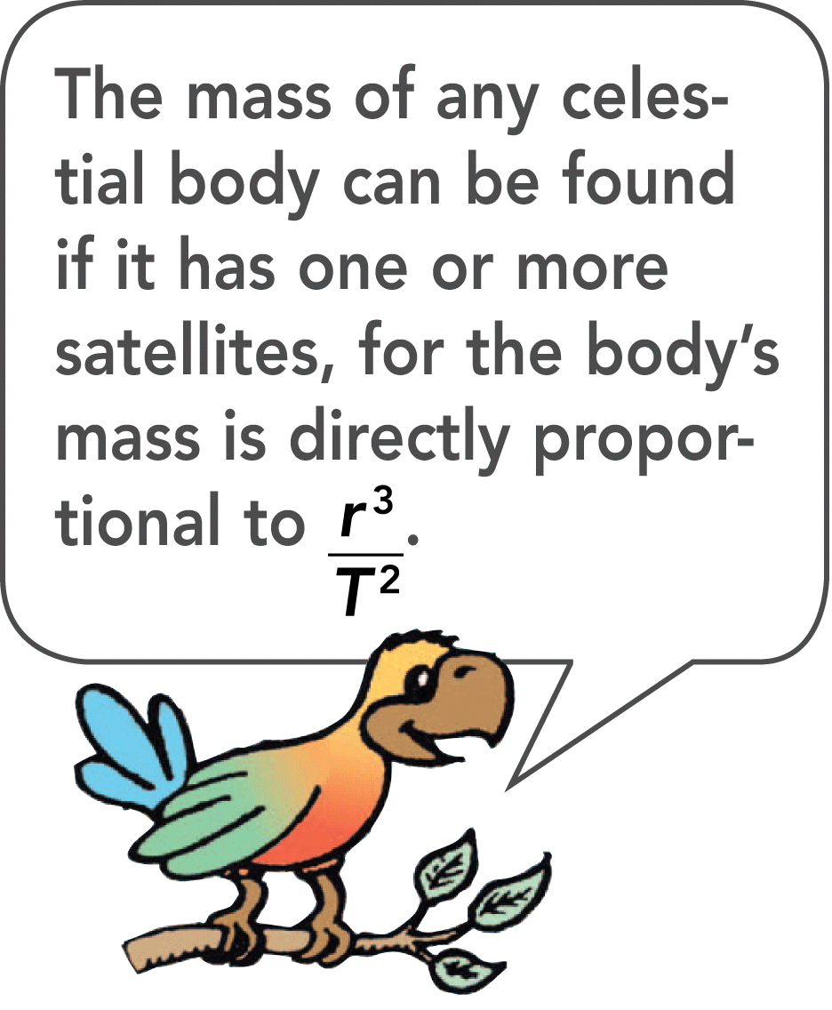
Kepler’s Laws of Planetary Motion
This means that the ratio is the same for all planets.
If a planet’s period is known, its average orbital radial distance is easily calculated.
Kepler’s laws apply not only to planets but also to moons or any satellite in orbit around any body.

Slide 52
Kepler’s Laws of Planetary Motion
Kepler was familiar with Galileo’s concepts of inertia and accelerated motion, but he failed to apply them to his own work.
Like Aristotle, he thought that the force on a moving body would be in the same direction as the body’s motion.
Kepler never appreciated the concept of inertia. Galileo, on the other hand, never appreciated Kepler’s work and held to his conviction that the planets move in circles.

Slide 53
Energy Conservation and Satellite Motion
Recall the following:
Object in motion possesses KE due to its motion.
Object above Earth’s surface possesses PE by virtue of its position.
Satellite in orbit possesses KE and PE.
  Sum of KE and PE is constant at all points in the orbit.

Slide 54
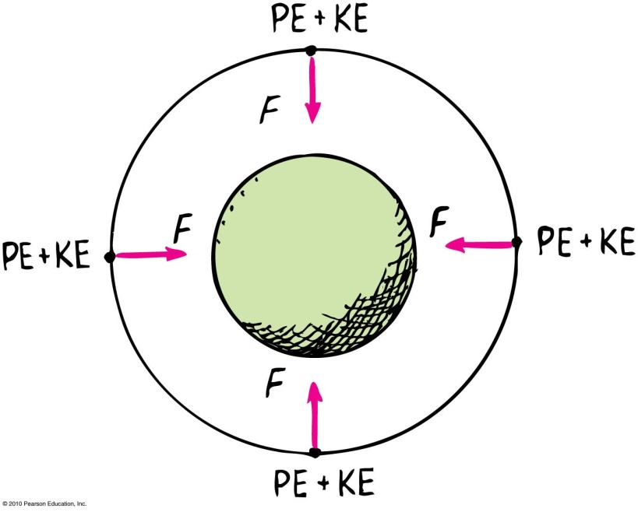
Energy Conservation and Satellite Motion
PE, KE, and speed in circular orbit:
  Unchanged.
  distance between the satellite and center of the attracting body does not change—PE is the same everywhere.
  no component of force acts along the direction of motion—no change in speed and KE.

Slide 55
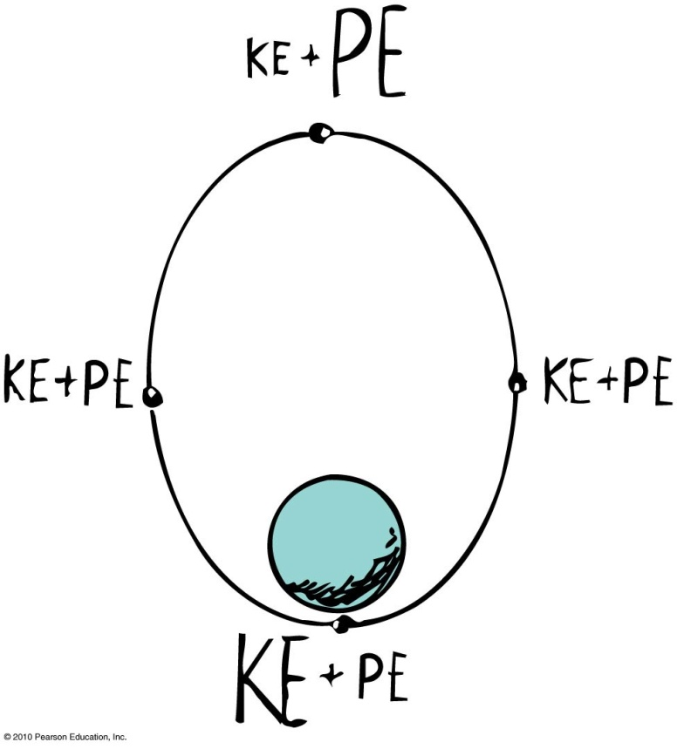
Energy Conservation and Satellite Motion
Elliptical Orbit Varies.
  PE is greatest when the satellite is farthest away (apogee).
  PE is least when the satellite is closest (perigee).
  KE is least when PE is the most and vice versa.
  At every point in the orbit, sum of KE and PE is the same.

Slide 56
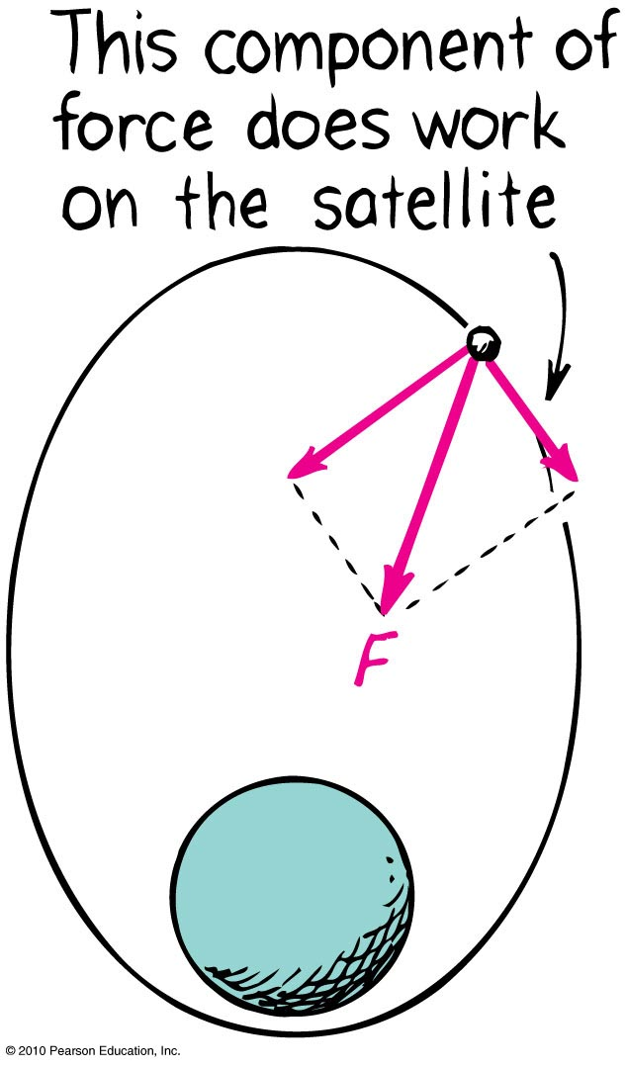
Energy Conservation and Satellite Motion
When satellite gains altitude
and moves against gravitational
force, its speed and KE decrease
and decrease continues to the apogee.
Past the apogee, satellite moves
in the same direction as the force
component and speed and KE
increase. Increase continues
until past the perigee and cycle
repeats.

Slide 57
Escape Speed
When a payload is put into Earth-orbit by a rocket, the speed and direction of the rocket are very important.
If the rocket were launched vertically and quickly achieved a speed of 8 km/s, it would soon come crashing back at 8 km/s.
To achieve orbit, the payload must be launched horizontally at 8 km/s once above air resistance.

Slide 58
Escape Speed
The Solar System
The escape speed from the sun is 620 km/s at the surface of the sun.
Even at a distance equaling that of Earth’s orbit, the escape speed from the sun is 42.2 km/s.
A projectile fired from Earth at 11.2 km/s escapes Earth but not necessarily the moon, and certainly not the sun.

Slide 59
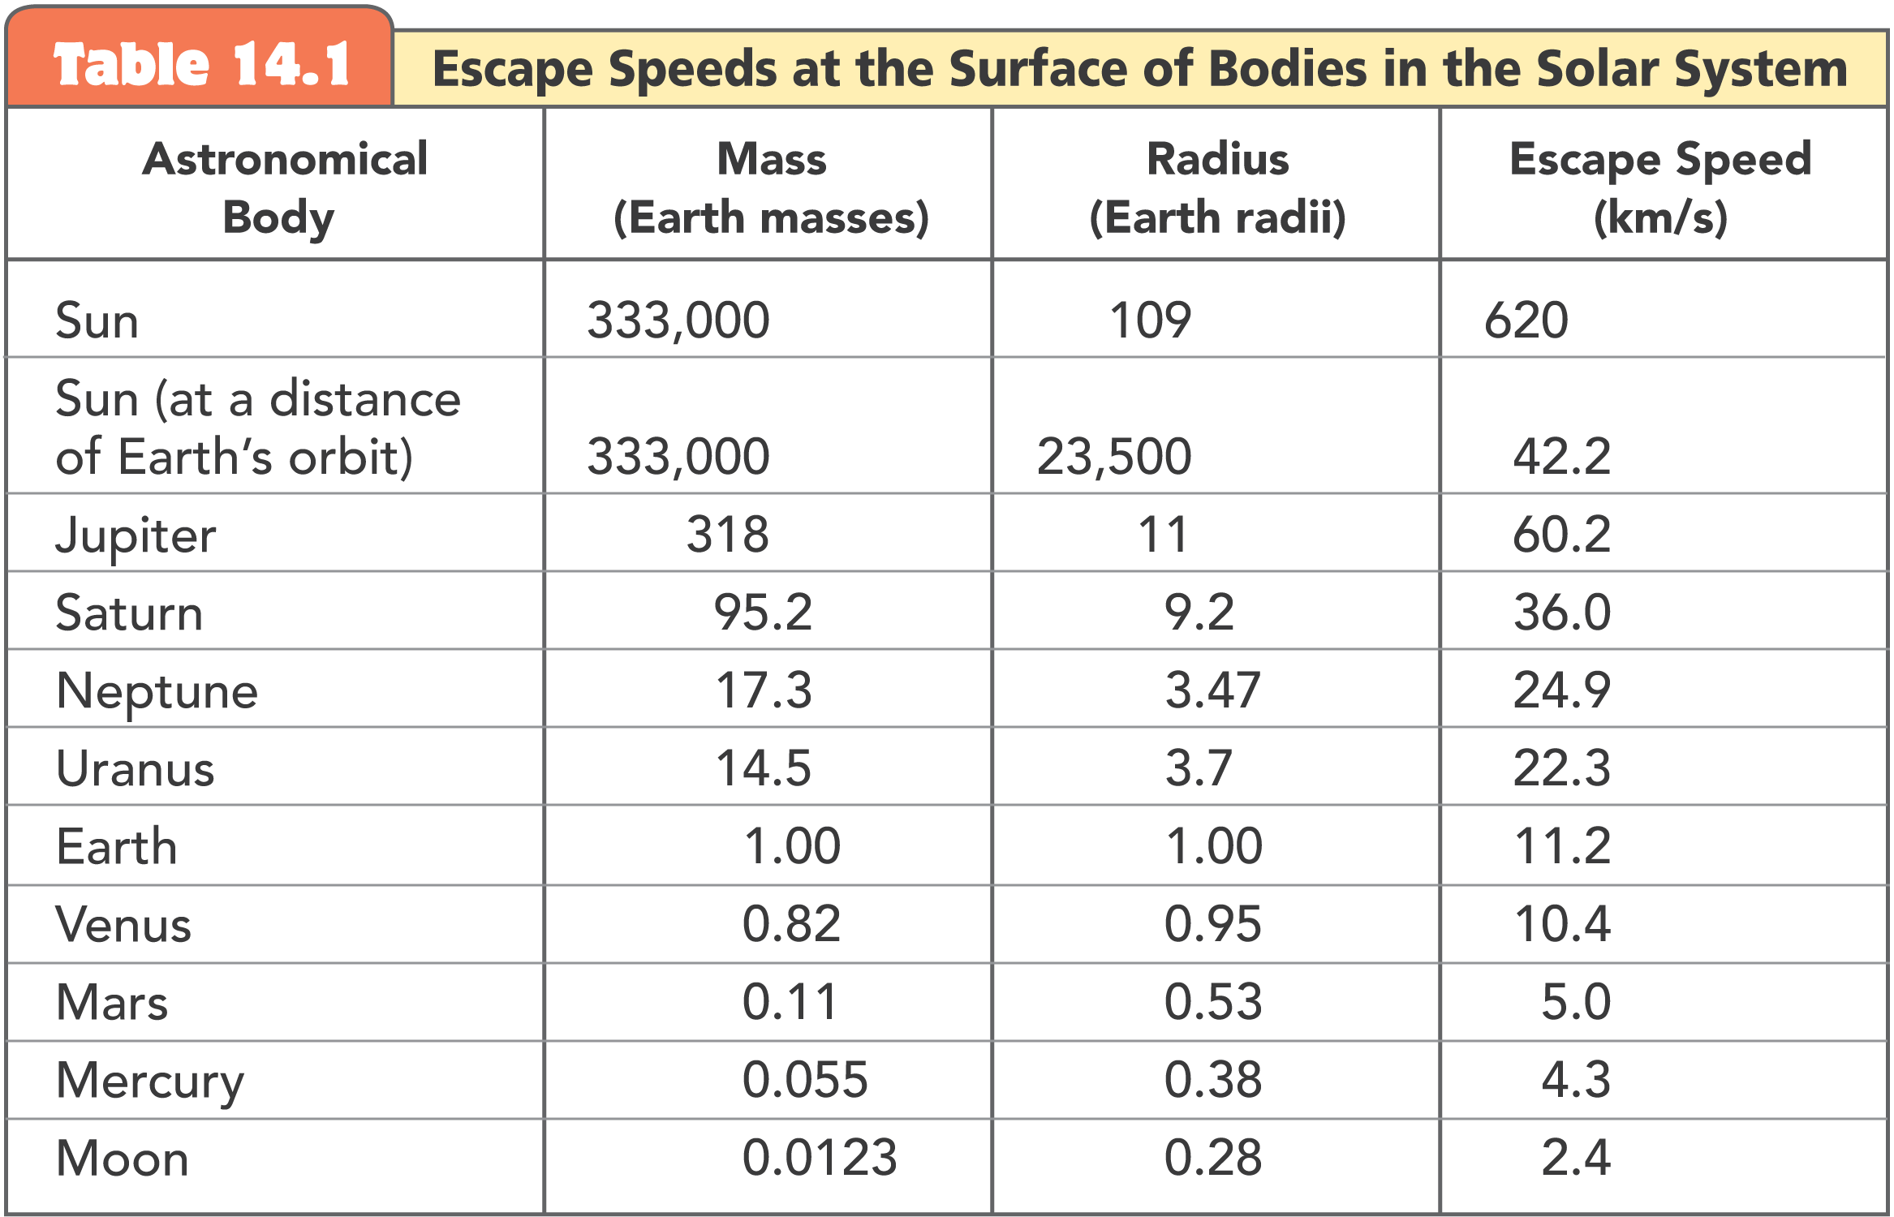
Escape Speed

Slide 60
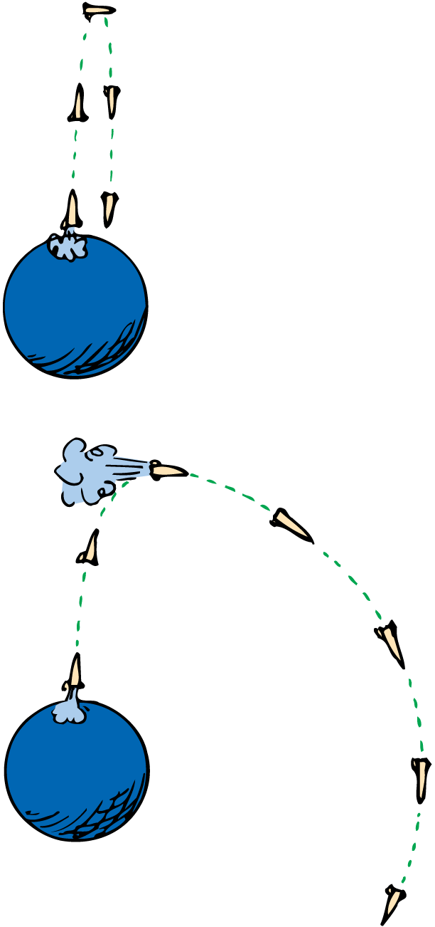
Escape Speed
The initial thrust of the rocket lifts it vertically. Another thrust tips it from its vertical course. When it is moving horizontally, it is boosted to the required speed for orbit.

Slide 61
Escape Speed
Earth
Neglecting air resistance, fire anything at any speed greater than 11.2 km/s, and it will leave Earth, going more and more slowly, but never stopping.

Slide 62
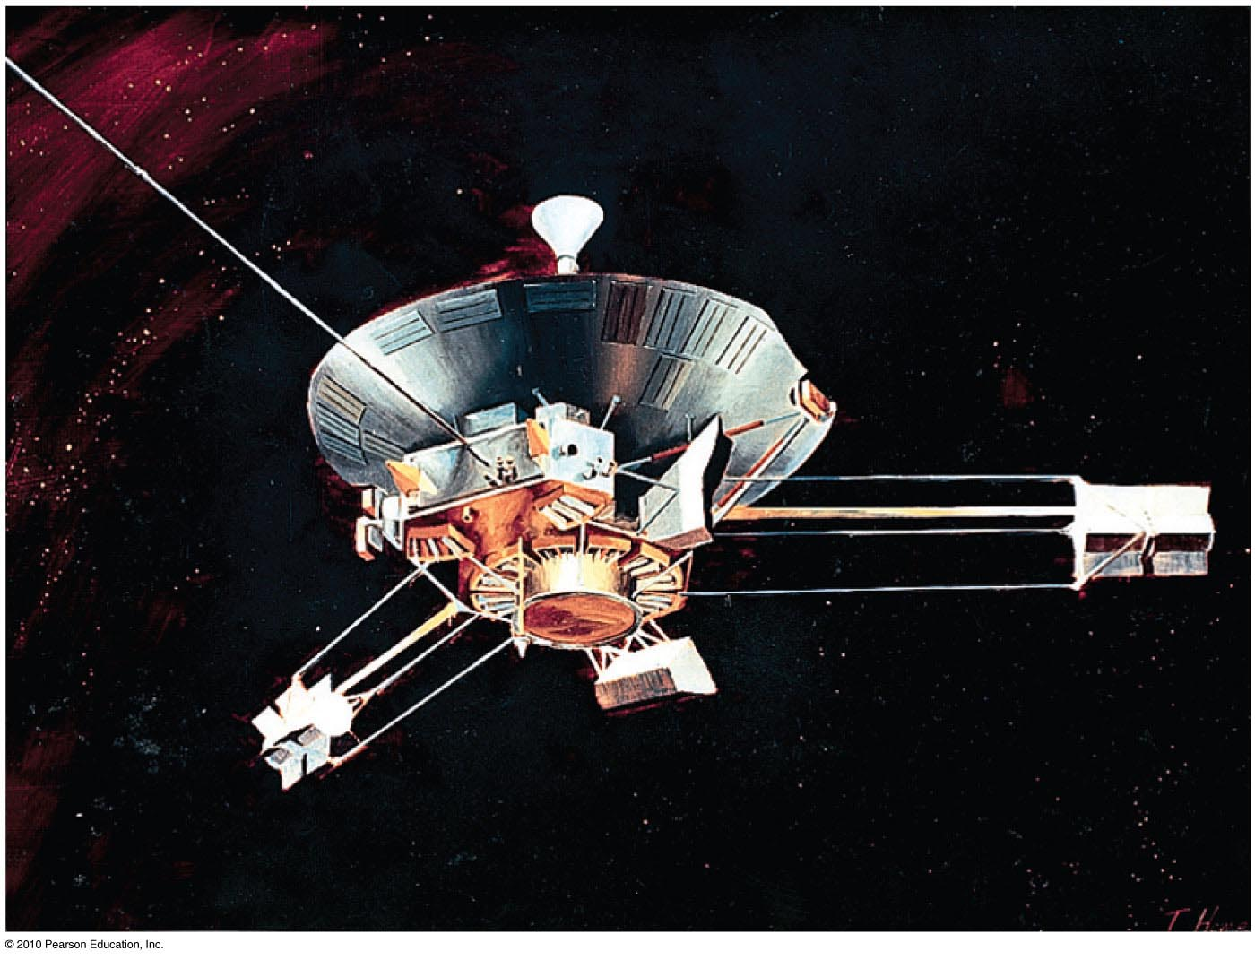
Escape Speed
First probe to escape the solar system was Pioneer 10, launched from Earth in 1972.
  Accomplished by directing the probe into the path of oncoming Jupiter

Slide 63
When a projectile achieves escape speed from Earth, it
Escape Speed
CHECK YOUR NEIGHBOR
A. forever leaves Earth’s gravitational field.
outruns the influence of Earth’s gravity, but is never beyond it.
comes to an eventual stop, returning to Earth at some future time.
All of the above.
Notes:
B. outruns the influence of Earth’s gravity, but is never beyond it.

Slide 64
When a projectile achieves escape speed from Earth, it
Escape Speed
CHECK YOUR ANSWER
A. forever leaves Earth’s gravitational field.
outruns the influence of Earth’s gravity, but is never beyond it.
comes to an eventual stop, returning to Earth at some future time.
All of the above.
Notes:
B. outruns the influence of Earth’s gravity, but is never beyond it.

Slide 65
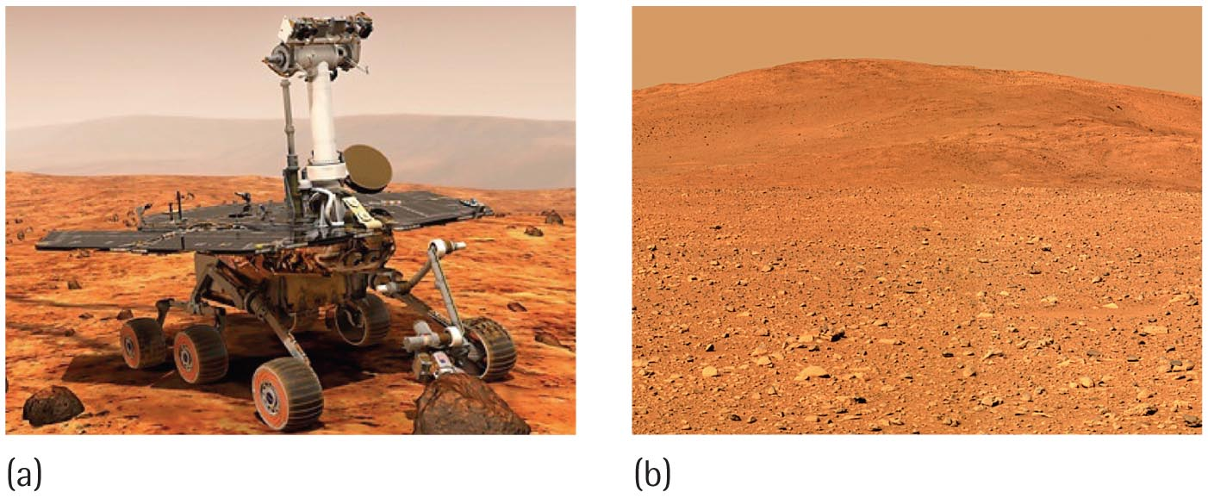
Escape Speed
Voyages to the Moon, Mars, and beyond begin with launches that exceed escape speed from Earth.

